Slide 1
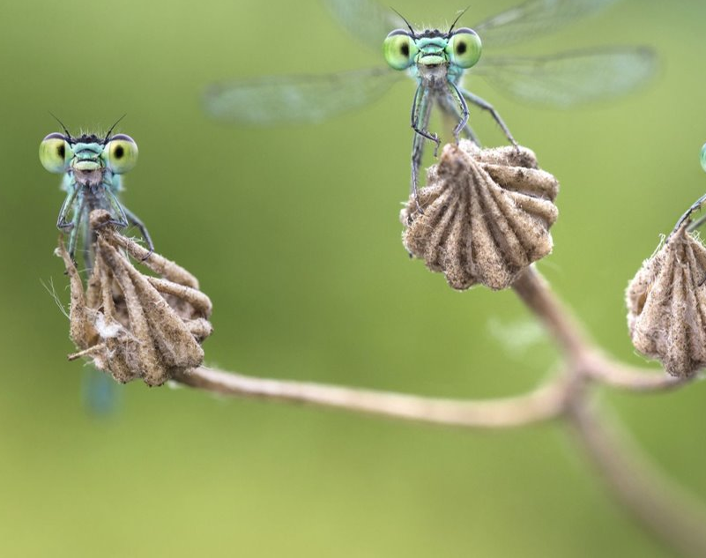
INSECTS IMAGE CLASSIFICATION AND DETECTION
SIDDHI JADHAV, NICOLE KOSHY & TINA JOSEPH

Slide 2

AGENDA
Introduction
Dataset
Approach
Image Classification
Object Detection along with Image Classification

Slide 3
INTRODUCTION
Insects are a diverse group with over 120 Taxonomic orders and about 1.3 million species of Arthropods described.
Insects across different taxonomical orders share similar shapes and structures, which can make classification even at higher levels challenging, in some cases.
We have used custom and pre-trained classification models to address this problem.

Slide 4
Datasets
Kaggle dataset – ArTaxOr – A set of ~16000 annotated images split into 8 taxonomic orders. ~12 GB in size
Mobile Corpus – A set of ~14000 unannotated mobile phone images organized in a similar manner to ArTaxOR. ~ 50 GB in size [DL Testing Set]
To determine test accuracy of the trained models, smaller subsets of these images (subset of one or the other dataset [DL Small Set] or a mix of both were used [DL Small Artax_Mobl Mix])

Slide 5
Approach
Classification –
CNN,
Transfer Learning.
Custom Models
Object detection –YOLO
Goal - Enhance accuracy of prediction

Slide 6
Image Classification
Models used:
ØInceptionV3 base model and custom features
ØDenseNet
ØResnet
ØCustom CNN Models
Ø MobilenetV2
Weights – Imagenet for Transfer learning models
As far as possible, models were trained on either ArTaxOr or the Mobile Corpus as tested on the other along with other smaller datasets.

Slide 7
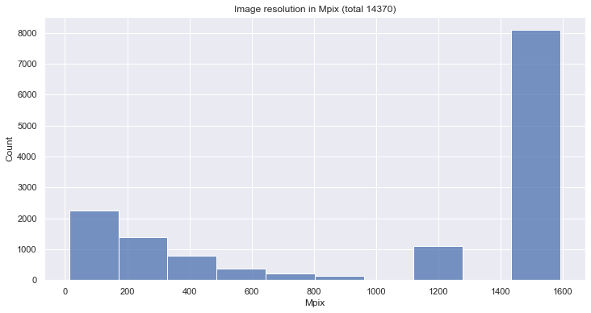
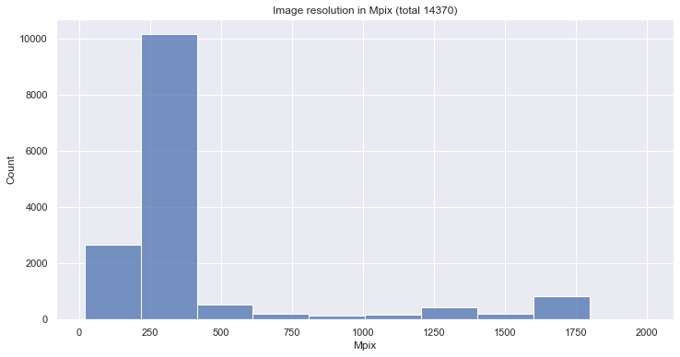
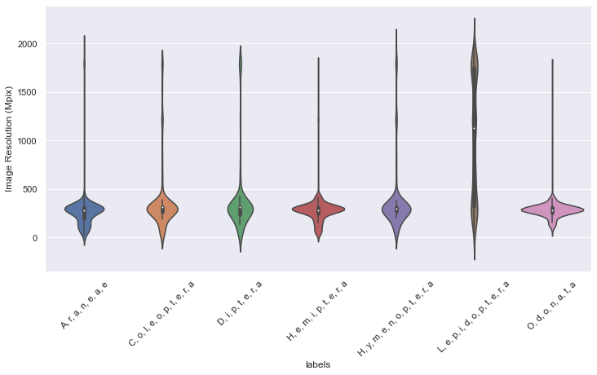
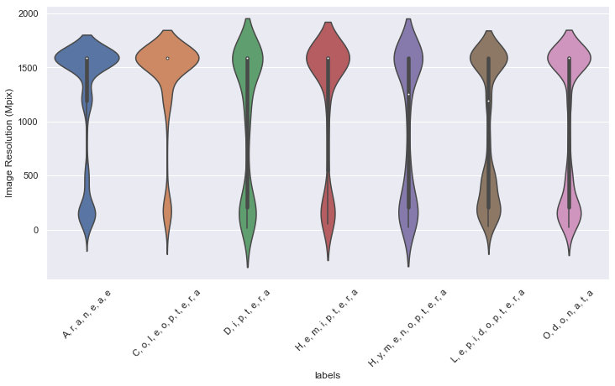
Image Size Distribution Analysis
Mobile Corpus
ArTaxOr

Slide 8
Approach
MODEL ARCHITECTURES

Slide 9
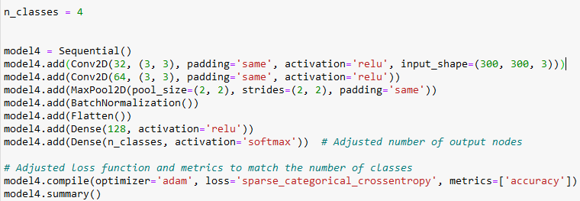
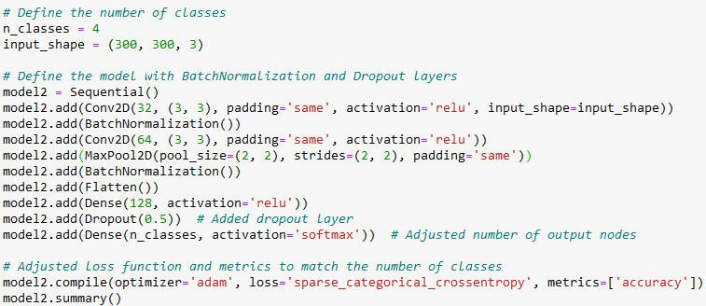
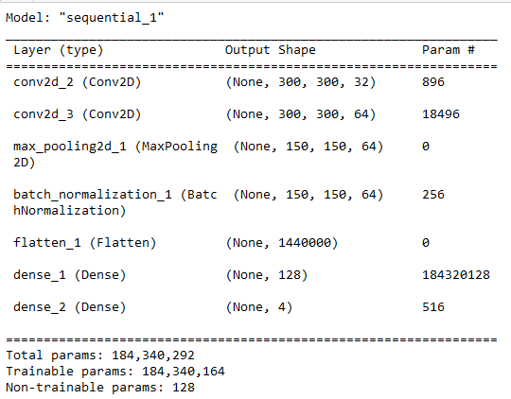
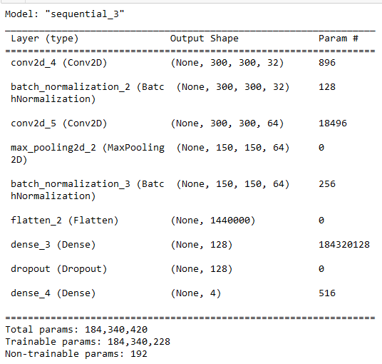
Custom CNN 1
Custom CNN 2

Slide 10
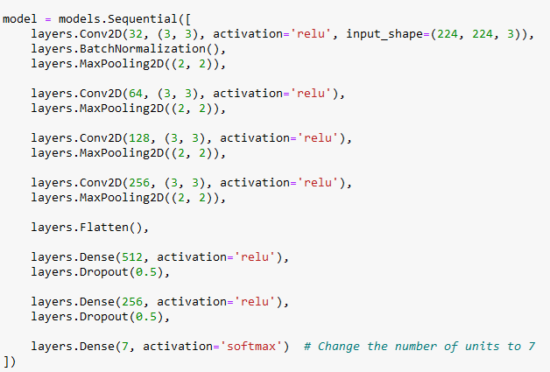
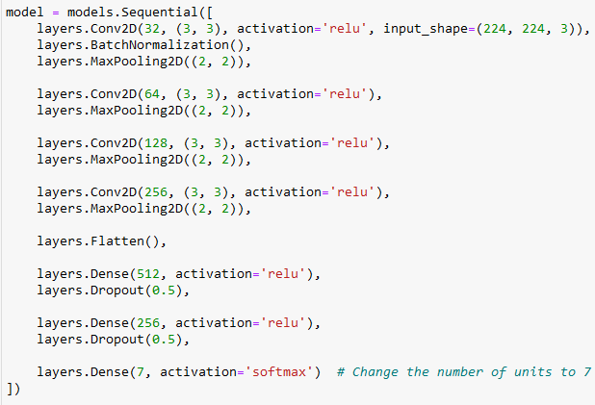
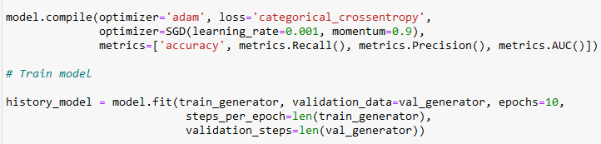
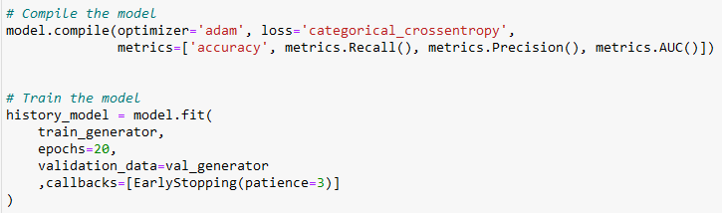
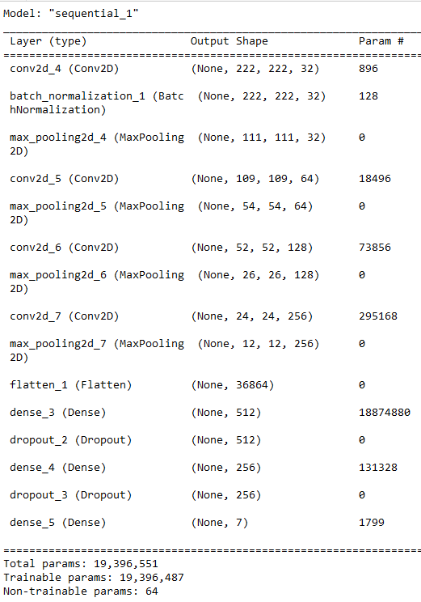
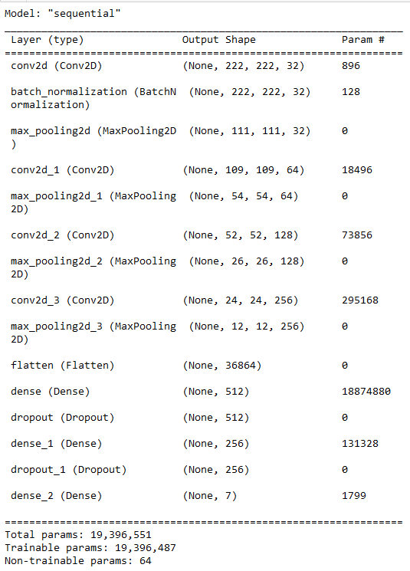
Custom CNN 3
Custom CNN 4

Slide 11
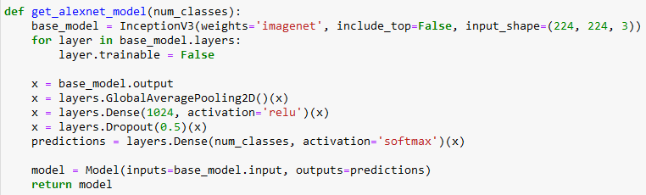
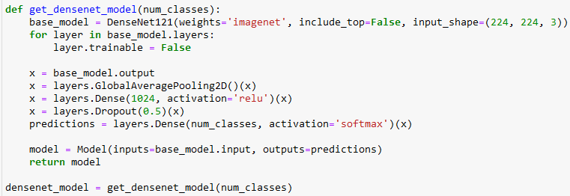
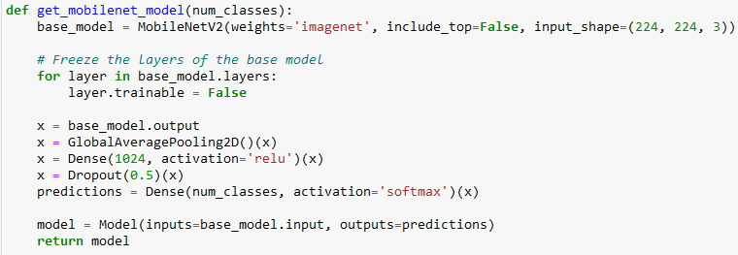
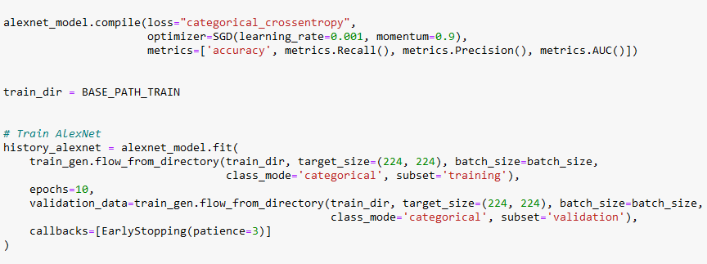
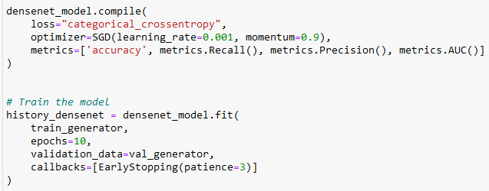
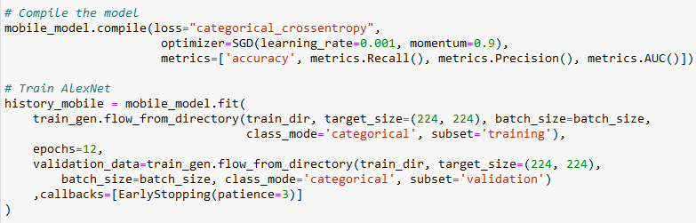
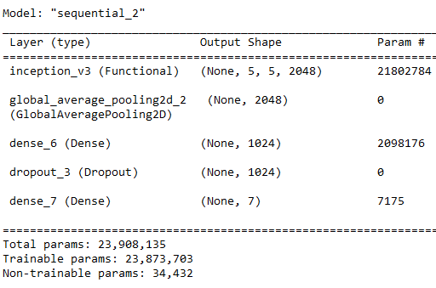
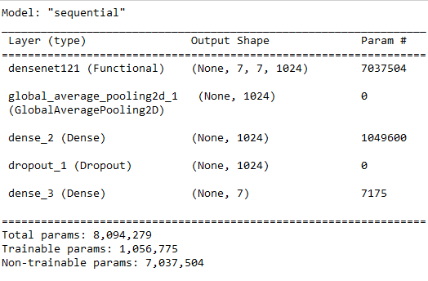
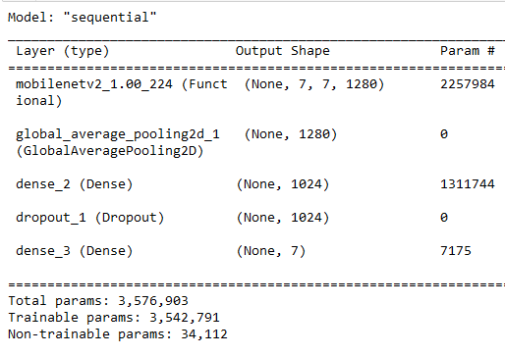
InceptionV3
DenseNet121
Mobile Net

Slide 12
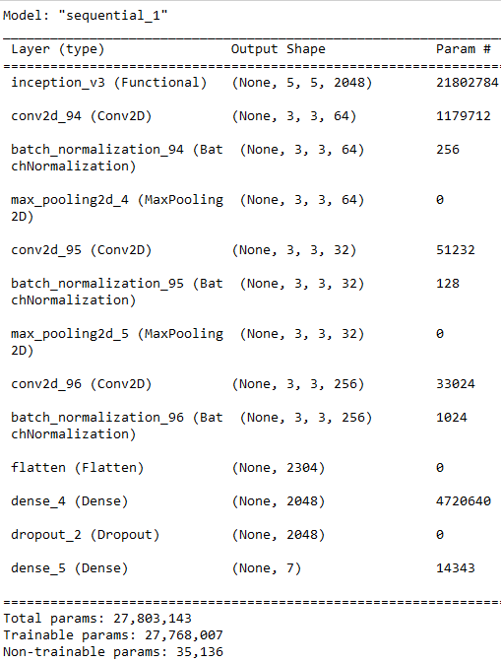
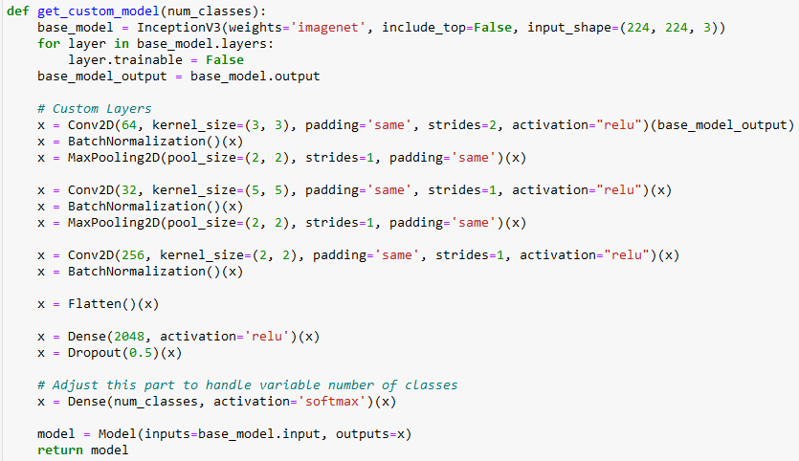
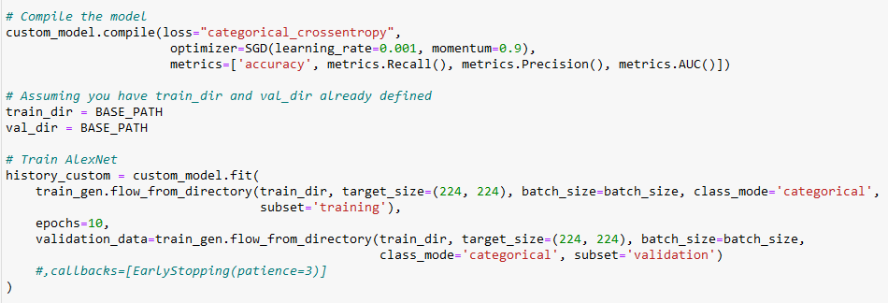
Custom InceptionV3
Custom InceptionV3
Inceptionv3
Dense net

Slide 13
CONSOLIDATED RESULTS
 |  |  |  |  | TEST ACCURACY
Pre-trained model | Model name | Train Dataset | Train Accuracy | Validation Accuracy | Mobile | ArTaxOr | DL Small Artax_Mobl Mix
DenseNet | artxdensenet_model.h5 | ArTaxOR | 0.6849 | 0.1141 | 0.453 | 0.6021 | 0.6114
DenseNet | mobdensenet_model.h5 | Mobile | 0.8487 | 0.6955 | 0.8456 | 0.5526 | 0.7031
MobileNet | artxmobilenet_model.h5 | ArTaxOR | 0.6758 | 0.6625 | 0.6333 | 0.6986 | 0.6681
MobileNet | mobmobilenet_model.h5 | Mobile | 0.8345 | 0.7292 | 0.835 | 0.5047 | 0.6288
InceptionV3 | alexnet_modelv2.h5 | ArTaxOR | 0.7088 | 0.687 | 0.7003 | 0.7318 | 0.7249
InceptionV3 | alexnet_modelv3.h5 | Mobile | 0.7922 | 0.7126 | 0.8224 | 0.5458 | 0.6288
Custom InceptionV3 | inceptionv3_model.h5 | ArTaxOR | 0.9257 | 0.6385 | 0.5863 | 0.869 | 0.6812
Custom InceptionV3 | mobinceptionv3_model.h5 | Mobile | 0.9923 | 0.7409 | 0.8361 | 0.4879 | 0.7293

Slide 14
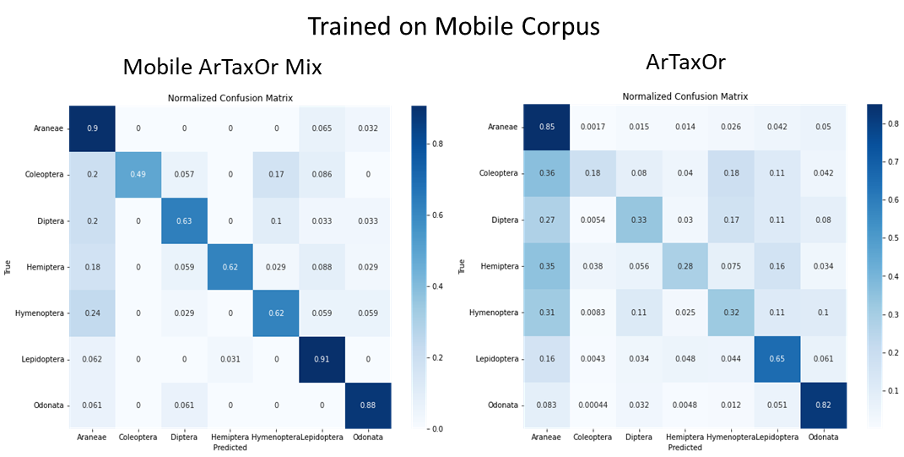
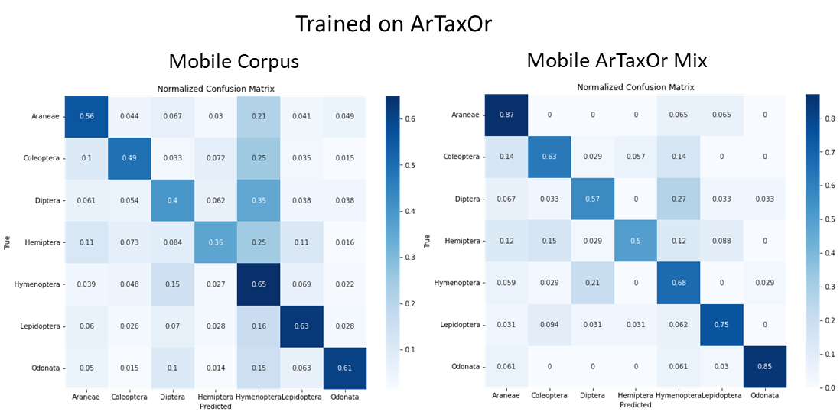
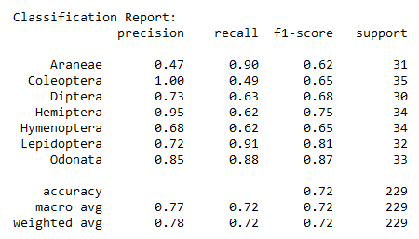
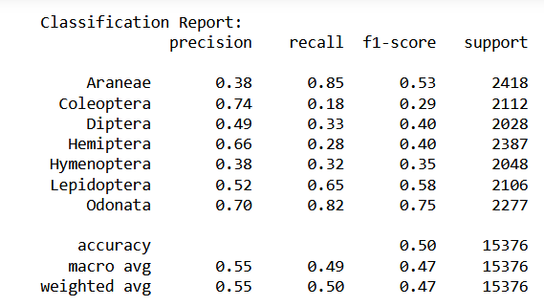
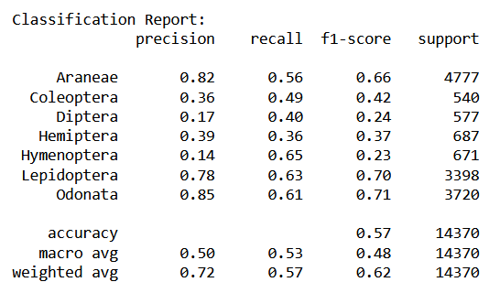
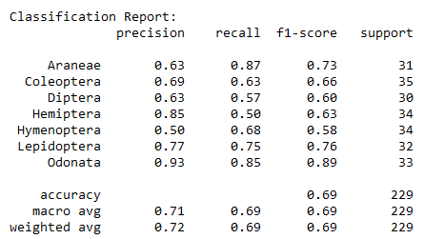
Custom Inceptionv3
Test Set | Test Accuracy
Mobile Corpus | 0.8361
Mobile ArTaxOr Mix | 0.7293
ArTaxOr | 0.4879
Test Set | Test Accuracy
Mobile Corpus | 0.5863
Mobile ArTaxOr Mix | 0.6812
ArTaxOr | 0.869
Train Accuracy | 0.9923
Val Accuracy | 0.7409
Train Accuracy | 0.9257
Val Accuracy | 0.6385

Slide 15
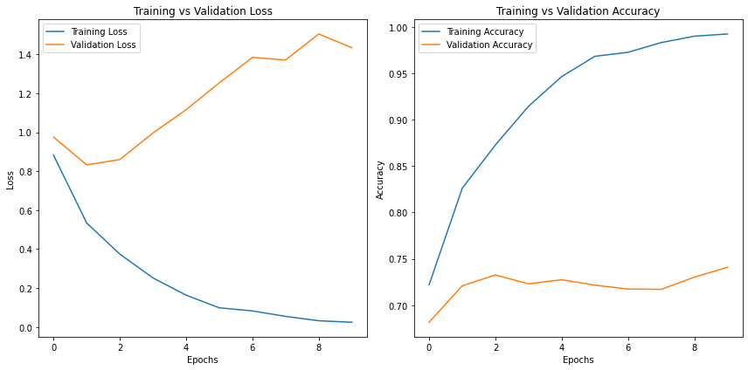
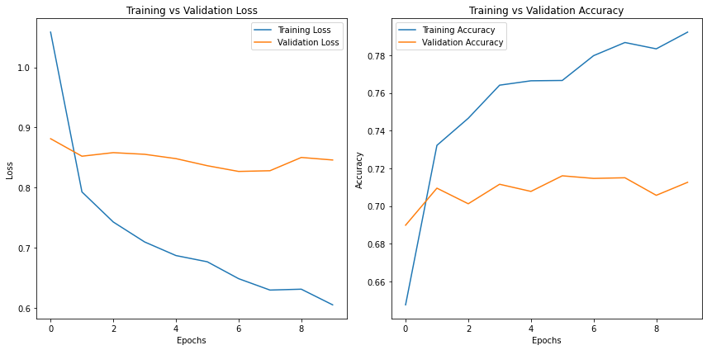
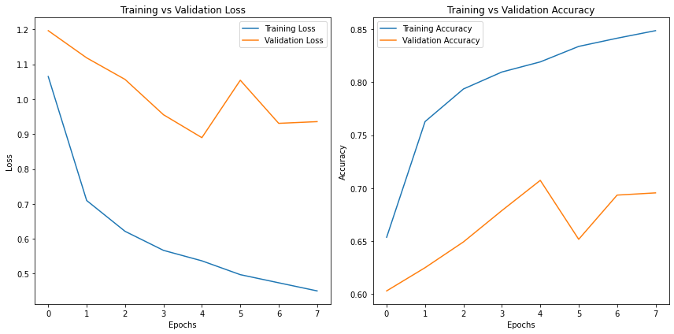
Models and Results - Trained with Mobile Corpus
Custom InceptionV3
Inceptionv3
Dense net

Slide 16
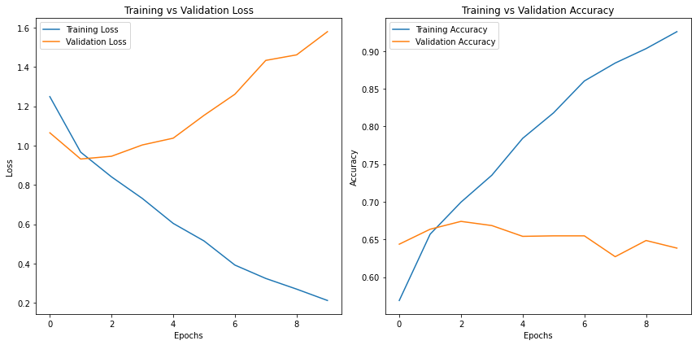
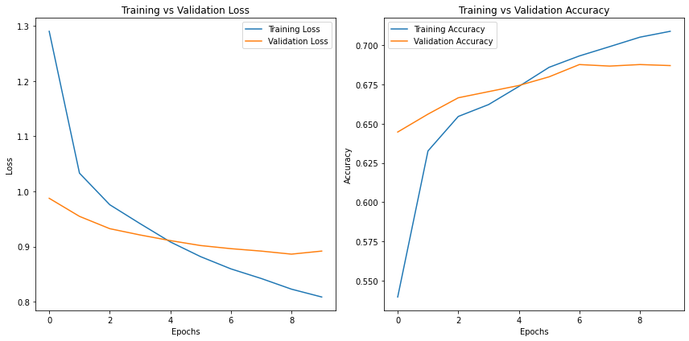
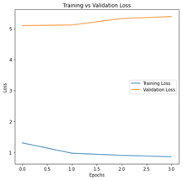
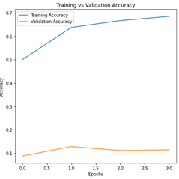
Models and Results - Trained with ArTaxOR
Custom InceptionV3
Inceptionv3
Dense net

Slide 17
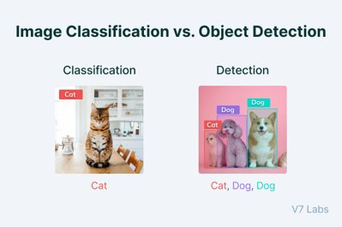
Object Detection
Image classification involves predicting the class of one object in an image.
Object localization refers to identifying the location of one or more objects in an image and drawing abounding box around their extent.
Object detection combines these two tasks and localizes and classifies one or more objects in an image.
Cat - 1
Dog - 0

Slide 18
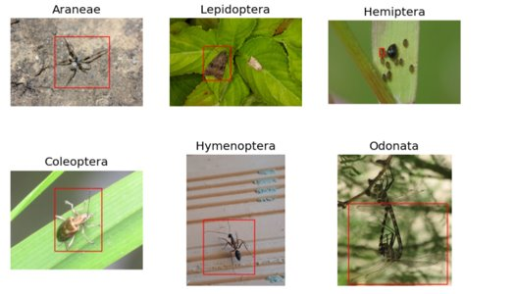
General Approach
The general approach is training the model, by training the custom dataset on the yolov8 model, first by annotating the data, using train test split, training, and validation followed by testing on test dataset.
We trained the model for 10 epochs using yolov8s

Slide 19
YOLOV8 Model
YOLOv8 is the newest state-of-the-art YOLO model that can be used for object detection, image classification, and instance segmentation tasks.
YOLOv8 was developed by Ultralytics, who also created the influential and industry-defining YOLOv5 model.
YOLOv8 includes numerous architectural and developer experience changes and improvements over YOLOv5.
Ultralytics - Ultralytics YOLOv8 is not just another object detection model; it's a versatile framework designed to cover the entire lifecycle of machine learning models—from data ingestion and model training to validation, deployment, and real-world tracking.

Slide 20
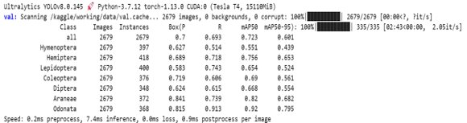
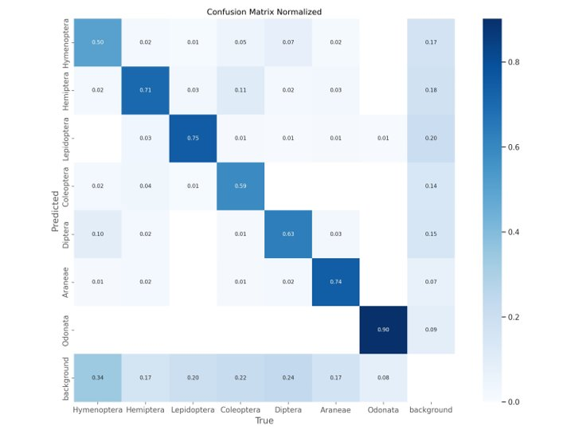
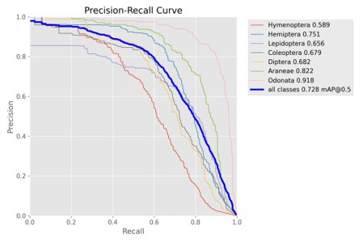
Results

Slide 21
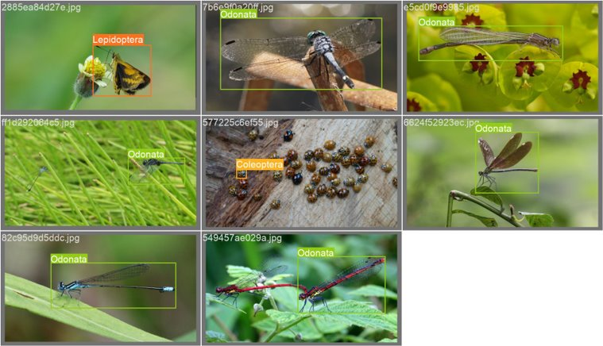
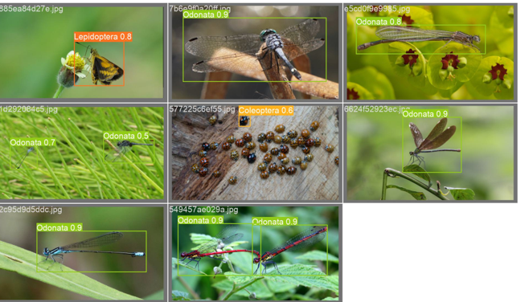
These images depict the ground truth labels
These visuals display the predictions made by the YOLOv8 model for the respective batches

Slide 22
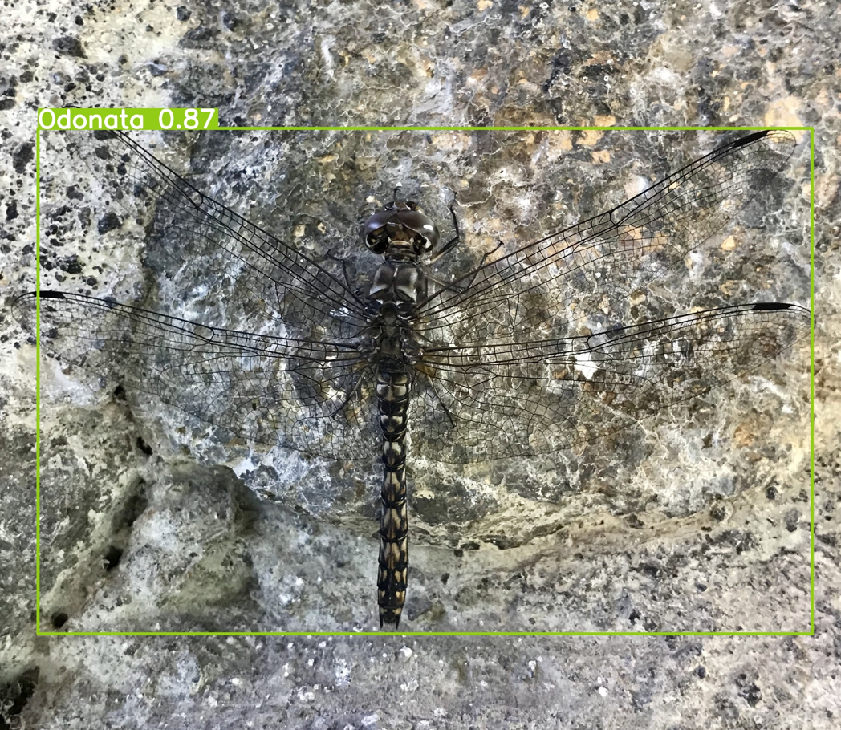
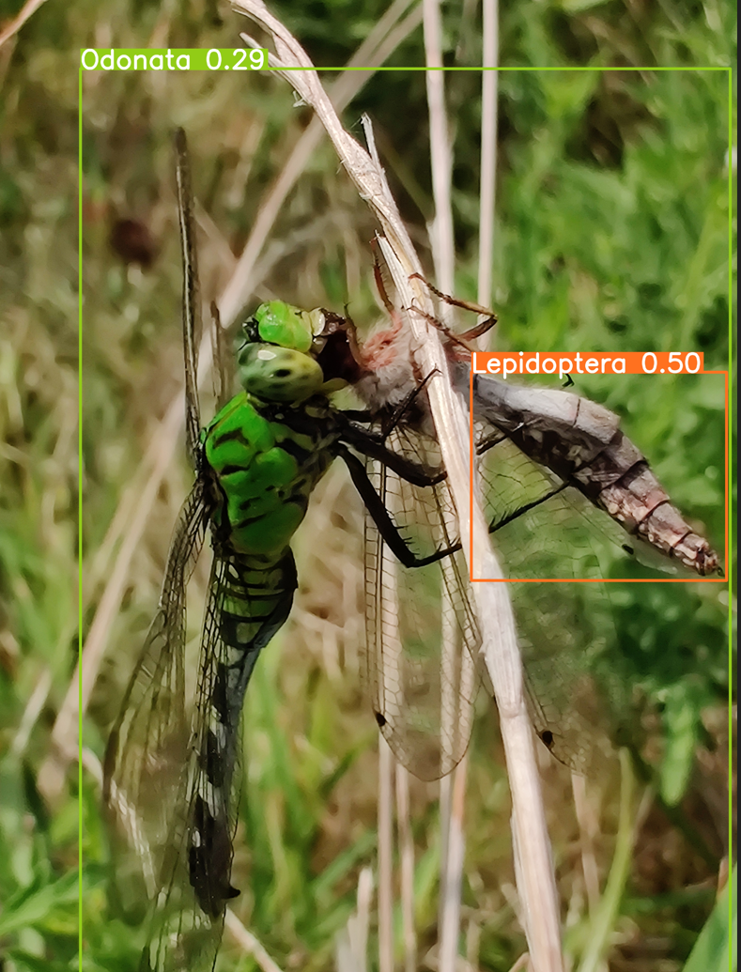
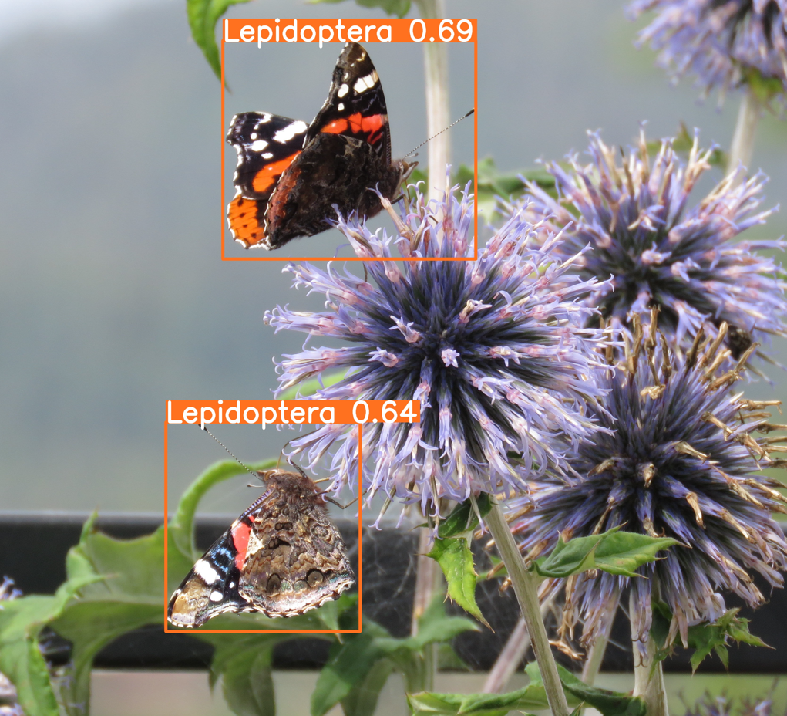




Slide 23

Test Mobile Corpus Dataset

Slide 24
Summary
In summary, the model performs reasonably well, achieving good precision, recall, and mAP (mean Average Precision) across different classes.
mAP at 50% IoU (mAP50): 0.723 for the "all" class is a solid indication of good overall performance.
mAP from 50% to 95% IoU (mAP50-95): 0.601 also provides insights into the model's performance under stricter criteria.
The confidence scores array shows the model's confidence in predicting each class.

Slide 25
THANK YOU

Slide 26
References
Home - Ultralytics YOLOv8 Docs
Roboflow: Give your software the power to see objects in images and video
https://www.kaggle.com/datasets/mistag/arthropod-taxonomy-orders-object-detection-dataset/code

